Slide 1

Chapter 2: Modeling Data in the Organization

Slide 2
Business Rules
Are statements that define or constrain some aspect of the business
Are derived from policies, procedures, events, functions
Are automated through DBMS software
Notes:
As part of any organization, data model is a representation of a business. It is an expression of business rules!
To design good data models, we need good business rules expressed clearly
Are statements that define or constrain some aspect of the business -> if you are a pizza shop, one of your business rules may be: we only deliver within 5 miles radius of our location. Or we only deliver within our zip code
Are derived from policies, procedures, events, functions – in this example, that would be a company policy.
Assert business structure
Control/influence business behavior
Are expressed in terms familiar to end users
Are automated through DBMS software

Slide 3
A Good Business Rule Is:
Atomic–one statement
Consistent–internally and externally
Business-oriented–understood by business-people
Notes:
Declarative–what, not how -> drives must deliver only within 5-mile radius. Don’t have to mention they have to used GPS.
Precise–clear, agreed-upon meaning
Atomic–one statement
Consistent–internally and externally
Expressible–structured, natural language
Distinct–non-redundant
Business-oriented–understood by businesspeople
Examples of a business rules:
A car with more than 5k accumulated miles must be scheduled for service.
To obtain your degree you must have an average GPA of 3.0

Slide 4
E-R Model Constructs
Entities:
Entity instance–person, place, object, event, concept (often corresponds to a row in a table)
Entity Type–collection of entities (often corresponds to a table)
Relationships:
Relationship instance–link between entities (corresponds to primary key-foreign key equivalencies in related tables)
Relationship type–category of relationship…link between entity types
Attribute–property or characteristic of an entity or relationship type (often corresponds to a field in a table)
Notes:
2
Entities:
Entity instance–person, place, object, event, concept (often corresponds to a row in a table)! A specific person would be a student like Raj Patel, or Lei Lee
Entity Type–collection of entities (often corresponds to a table) is all of you together.
Warn the students that the term “entity” is often used either way; the meaning is intended to come from the context in which it is used.
Relationships:
Relationship instance–link between entities (corresponds to primary key-foreign key equivalencies in related tables) students are registered to a class. Raj Patel is registered to INFO6210
Relationship type–category of relationship…link between entity types
Attribute–property or characteristic of an entity or relationship type (often corresponds to a field in a table). Students have a name and student id, social security numbers etc

Slide 5
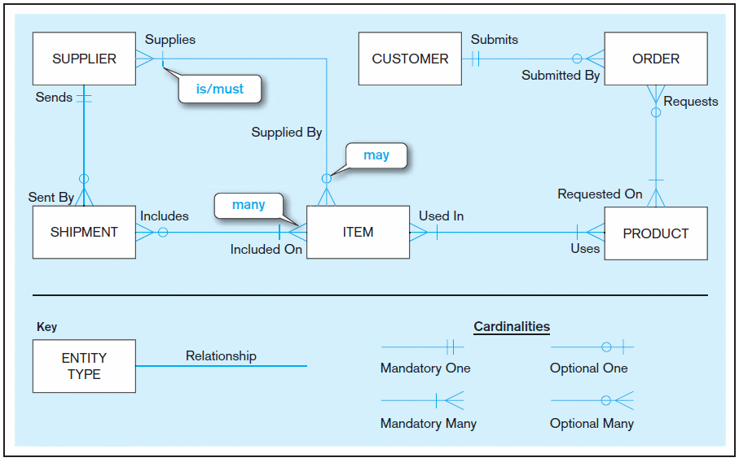
Sample E-R Diagram (Figure 2-1)
Notes:
3
What are the business rules represented in this model:
E.g.:
Supplier may supply an item to this organization, and all items must be supplied by a supplier
Let's go over a sample ER diagram of a company that receives its suppliers from a supplier and gets orders from a customer!

Slide 6
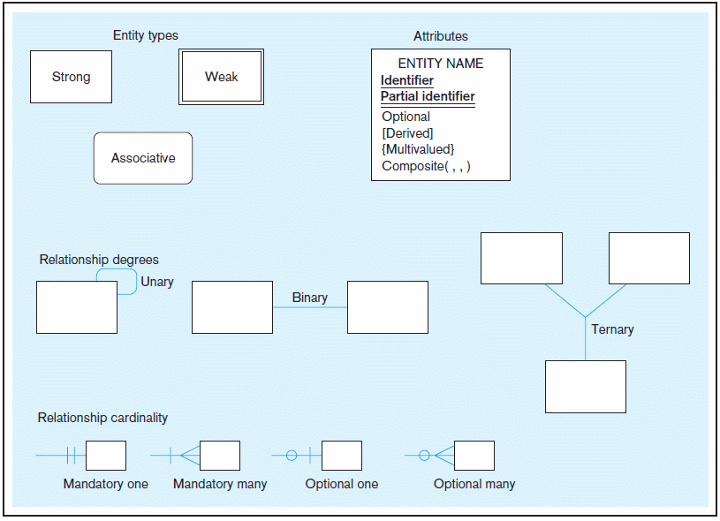
Basic E-R notation (Figure 2-2)
Entity symbols
Attribute symbols
A special entity that is also a relationship
Relationship symbols
Relationship degrees specify number of entity types involved
Relationship cardinalities specify how many of each entity type is allowed
Notes:
8
These are the ER-R notations will be using going forward
Diamond is not an acceptable notation for E-R! It it is used for Data Flow Diagram

Slide 7
An Entity…
SHOULD BE:
An object that will have many instances in the database
An object that will be composed of multiple attributes
An object that we are trying to model
SHOULD NOT BE:
A user of the database system
An output of the database system (e.g., a report)
Notes:
Entities are not data flow diagram, no decision points. Data goes from here to there, IF this then this!!!!
Entities are static!!! They are not data flow diagram

Slide 8
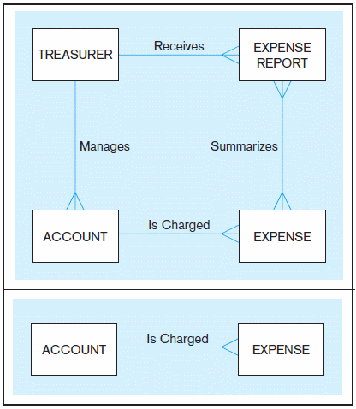
Figure 2-4 Example of inappropriate entities
System output
System
user
Inappropriate entities
Appropriate entities
Notes:
Give examples of common errors in E-R diagramming, including inappropriate entities (see Figure 2-4). Ask your students for other examples.
Difference between data flow diagram and E-R diagram!

Slide 9
Attributes - property or characteristic of an entity or relationship type
Required versus Optional Attributes
Simple versus Composite Attribute
Single-Valued versus Multivalued Attribute
Stored versus Derived Attributes
Identifier Attributes
Notes:
5
Required versus Optional Attributes → first name is required, middle name is optimal
Simple versus Composite Attribute -> composite means more than one part.
Single-Valued versus Multivalued Attribute ( more than one row)
Stored versus Derived Attributes ( attribute that be derived from others. Age based on DOB)
Identifier Attributes ( keys, Student IDs, SS# etc)
Examples of Required versus Optional Attributes: Middle Name should be optional for students.
Simple versus Composite Attribute: Home Address is a composite Attribute with 3 parts! Person’s Name is a composite
Single-Valued versus Multivalued Attribute: Students and skills, you can have many skills
Stored versus Derived Attributes; DOB is stored attribute, age is derived attribute
Identifier Attributes: Student ID, SS# , VIN #

Slide 10
Identifiers (Keys)
Identifier (Key)–an attribute (or combination of attributes) that uniquely identifies individual instances of an entity type
Simple versus Composite Identifier
Candidate Identifier–an attribute that could be a key…satisfies the requirements for being an identifier
Notes:
6
Identifier (Key)–an attribute (or combination of attributes) that uniquely identifies individual instances of an entity type ; What identifies a student? Student, simple means only one, composite means more than 1. Candidate, could be SS#
Simple versus Composite Identifier
Candidate Identifier–an attribute that could be a key…satisfies the requirements for being an identifier
Example of banking account number

Slide 11
Criteria for Identifiers
Choose Identifiers that
Will not change in value
Will not be null
Avoid intelligent identifiers (e.g., containing locations or people that might change)
Substitute new, simple keys for long, composite keys
Notes:
7
Would you want Middle Name as your key!!! No.
What is NULL? Unknown
Why is it important for an attribute not to be NULL? You need to track the identity of the entity instance through its existence.
Why person’s name is not a good identifier for a person?

Slide 12
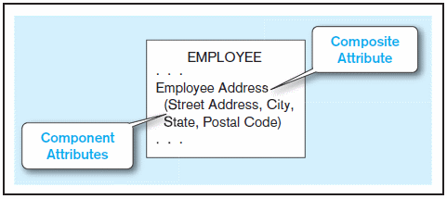
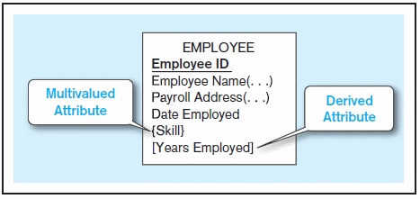
Figure 2-7 A composite attribute
An attribute broken into component parts
Figure 2-8 Entity with multivalued attribute (Skill)
and derived attribute (Years Employed)
Multivalued
an employee can have
more than one skill
Derived
from date employed and current date
Notes:
12

Slide 13
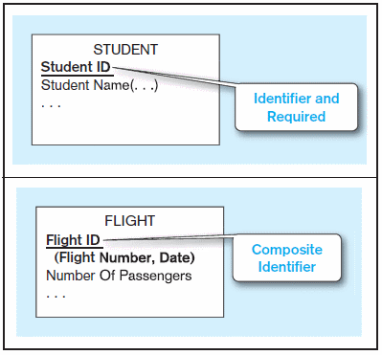


Figure 2-9 Simple and composite identifier attributes
The identifier is boldfaced and underlined
Notes:
14

Slide 14
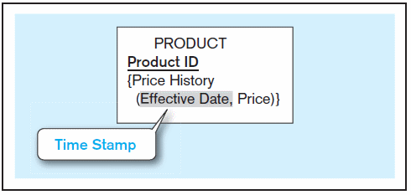
Figure 2-19 Simple example of time-stamping
This attribute is both multivalued and composite
Notes:
37

Slide 15
More on Relationships
Relationship Types vs. Relationship Instances
The relationship type is modeled as lines between entity types…the instance is between specific entity instances
Relationships can have attributes
These describe features pertaining to the association between the entities in the relationship
Two entities can have more than one type of relationship between them (multiple relationships)
Associative Entity–combination of relationship and entity
Notes:
Students as entity taught by Professors
Relationship type -> is a general representation of all students and all professor.
Relationship instance is the relationship between a specific student and a specific professor.
Two entities can have more than one type of relationship between them (multiple relationships) -> professor can teach students and mentor students

Slide 16
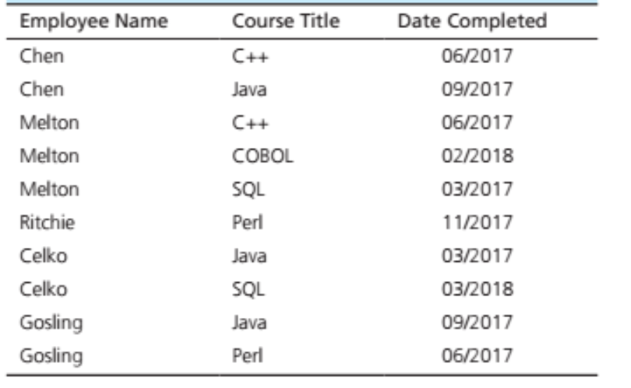
Relationship types and instances
Relationship instances
Notes:
17
Warn the students that the term “entity” is often used either way; the meaning is intended to come from the context in which it is used.

Slide 17
Degree of Relationships
Degree of a relationship is the number of entity types that participate in it
Unary Relationship
Binary Relationship
Ternary Relationship
Notes:
16

Slide 18
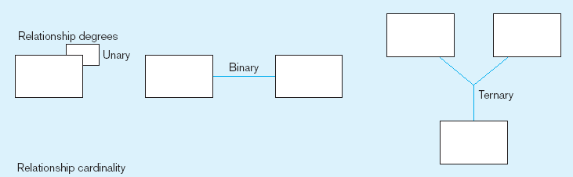
Degree of relationships – from Figure 2-2
Entities of two different types related to each other
One entity related to another of the same entity type
Entities of three different types related to each other
Notes:
8

Slide 19
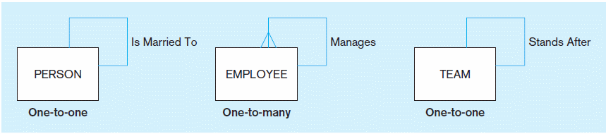
Figure 2-12 Examples of relationships of different degrees
a) Unary relationships
Notes:
22

Slide 20
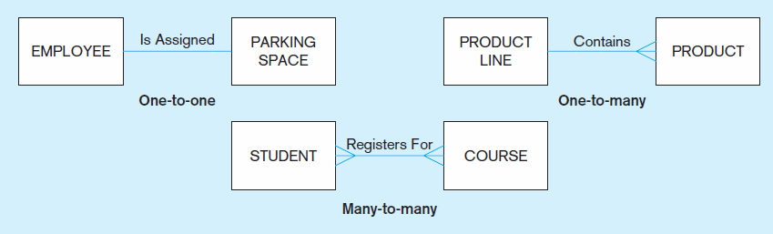
Figure 2-12 Examples of relationships of different degrees (cont.)
b) Binary relationships
Notes:
22

Slide 21
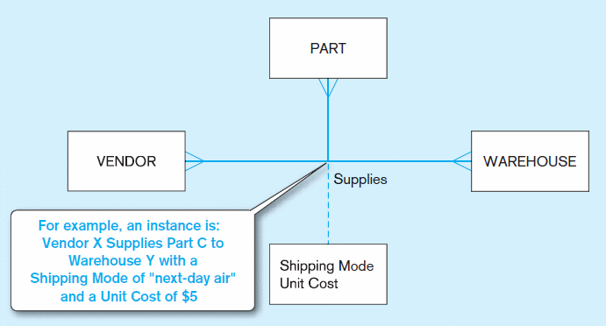
Figure 2-12 Examples of relationships of different degrees (cont.)
c) Ternary relationship
Note: a relationship can have attributes of its own
Notes:
22
This relationship also has an attribute of shipping mode.

Slide 22
Cardinality of Relationships
One-to-One
Each entity in the relationship will have exactly one related entity
One-to-Many
An entity on one side of the relationship can have many related entities, but an entity on the other side will have a maximum of one related entity
Many-to-Many
Entities on both sides of the relationship can have many related entities on the other side

Slide 23
Cardinality Constraints
Cardinality Constraints—the number of instances of one entity that can or must be associated with each instance of another entity
Minimum Cardinality
If zero, then optional
If one or more, then mandatory
Maximum Cardinality
The maximum number
Notes:
29

Slide 24
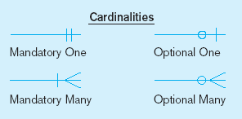
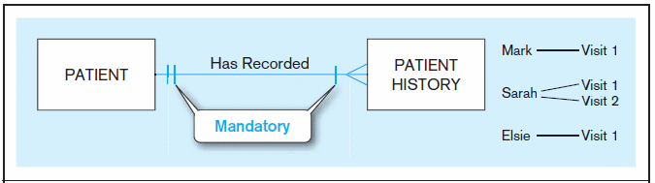
Figure 2-17 Examples of cardinality constraints
a) Mandatory cardinalities
A patient history is recorded for one and only one patient
A patient must have recorded at least one history, and can have many
Notes:
1
Can a patient exist without history? Not in this model

Slide 25
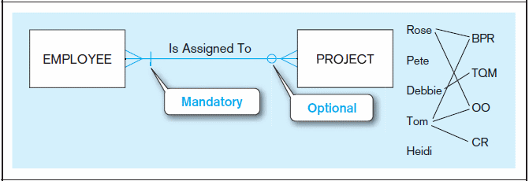
Figure 2-17 Examples of cardinality constraints (cont.)
b) One optional, one mandatory
A project must be assigned to at least one employee, and may be assigned to many
An employee can be assigned to any number of projects, or may not be assigned to any at all
Notes:
1

Slide 26
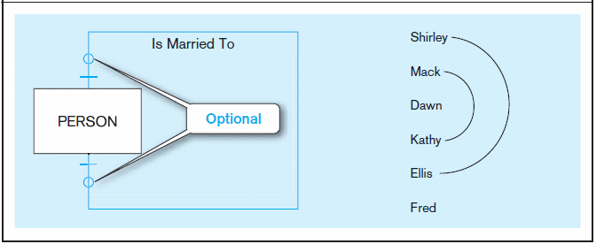
Figure 2-17 Examples of cardinality constraints (cont.)
c) Optional cardinalities
A person is married to at most one other person, or may not be married at all
Notes:
1

Slide 27
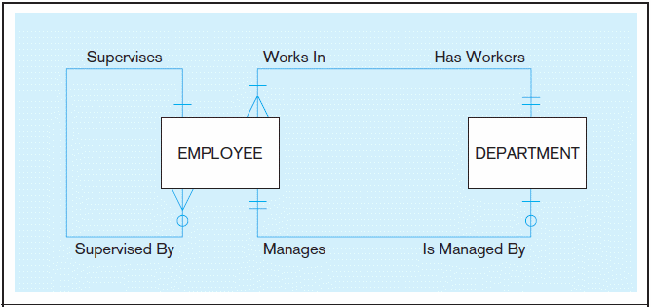
Figure 2-21 Examples of multiple relationships
a) Employees and departments
Entities can be related to one another in more than one way
Notes:
40

Slide 28
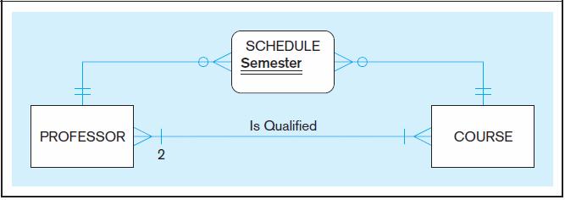
Figure 2-21 Examples of multiple relationships (cont.)
b) Professors and courses (fixed lower limit constraint)
Here, min cardinality constraint is 2. At least two professors must be qualified to teach each course. Each professor must be qualified to teach at least one course.
Notes:
40
Discuss unary, binary, and ternary relationships (Figure 2-12). Have the students brainstorm at least two additional examples for each of these relationship degrees.

Slide 29
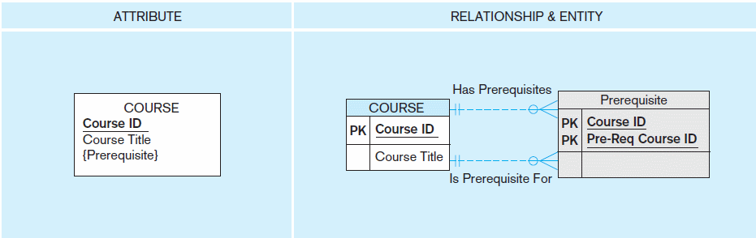
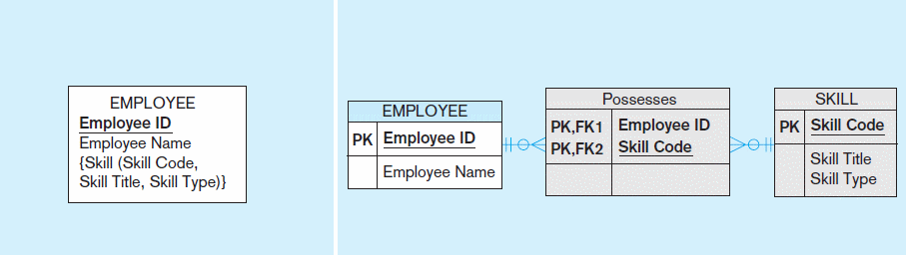
Figure 2-15a and 2-15b Multivalued attributes can be represented as relationships
simple
composite

Slide 30
Strong vs. Weak Entities, and Identifying Relationships
Strong entity
exists independently of other types of entities
has its own unique identifier
identifier underlined with single line
Weak entity
dependent on a strong entity (identifying owner)…cannot exist on its own
does not have a unique identifier (only a partial identifier)
partial identifier underlined with double line
entity box has double line
Identifying relationship
links strong entities to weak entities
Notes:
Provide some examples of strong and week entities:
Employee and dependent:
A room can only exist if you have a building
What about CAR and tire? A tire could exist without a car?

Slide 31
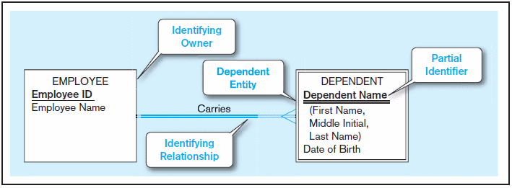
Figure 2-5 Example of a weak identity and its identifying relationship
Strong entity
Weak entity

Slide 32
Associative Entities
An entity–has attributes
A relationship–links entities together
When should a relationship with attributes instead be an associative entity?
All relationships for the associative entity should be many
The associative entity could have meaning independent of the other entities
The associative entity preferably has a unique identifier, and should also have other attributes
The associative entity may participate in other relationships other than the entities of the associated relationship
Ternary relationships should be converted to associative entities

Slide 33
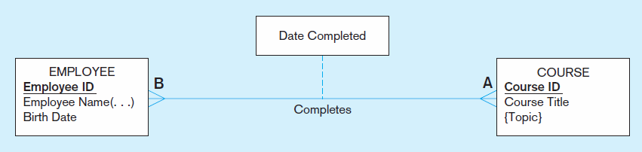
Figure 2-11a A binary relationship with an attribute
Here, the date completed attribute pertains specifically to the employee’s completion of a course…it is an attribute of the relationship
Notes:
20

Slide 34
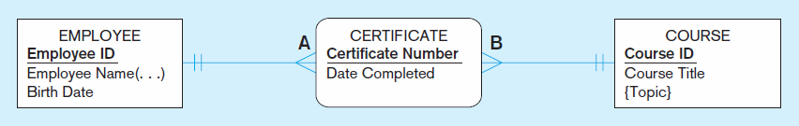
Figure 2-11b An associative entity (CERTIFICATE)
Associative entity is like a relationship with an attribute, but it is also considered to be an entity in its own right
Note that the many-to-many cardinality between entities in Figure 2-11a has been replaced by two one-to-many relationships with the associative entity
Notes:
21
There is a business expression for that relationship and an identifier

Slide 35
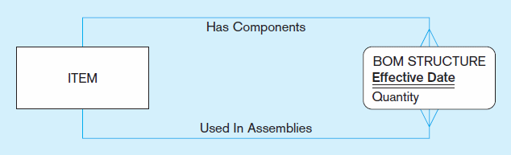
Figure 2-13c An associative entity – bill of materials structure
This could just be a relationship with attributes…it’s a judgment call
Notes:
27

Slide 36
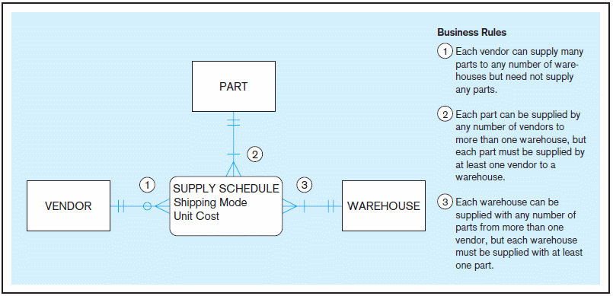
Figure 2-18 Cardinality constraints in a ternary relationship
Notes:
36

Slide 37
Problem
Each semester, each student must be assigned an adviser who counsels students about degree requirements and helps students register for classes. Each student must register for classes with the help of an adviser, but if the student’s assigned adviser is not available, the student may register with any adviser. We must keep track of students, the assigned adviser for each, and the name of the adviser with whom the student registered for the current term.
Represent this situation of students and advisers with an E-R diagram

Slide 38
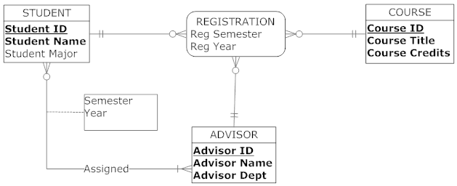

Slide 39
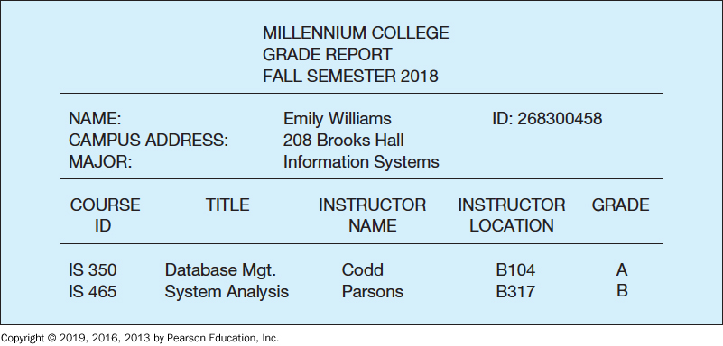
Figure below shows a grade report that is mailed to students at the end of each semester. Prepare an ERD reflecting the data contained in the grade report. Assume that each course is taught by one instructor. Explain what you chose for the identifier of each entity type on your ERD

